Slide 1
ICAO Asia-Pacific PBN Seminar
ICAO Regional Office, Bangkok, Thailand,
8-10 June 2015

Slide 2
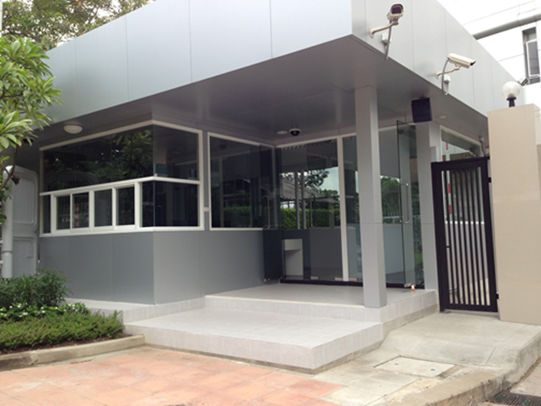
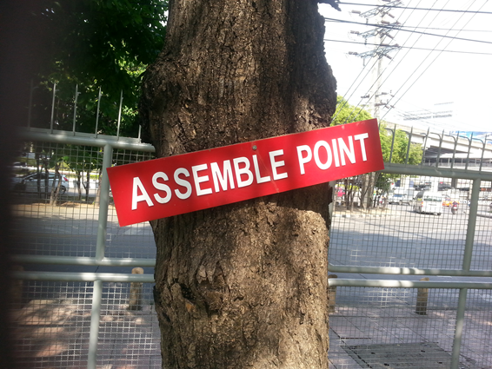
Administration
Building layout, administration, washrooms and security
Schedule
Breaks and meals
Welcome Reception
Reference material and handouts
Exhibition booths –
AEROTHAI, Airbus, AAI, Boeing, Egis, Honeywell, NEC, SAA

